Slide 1
ANOMALY DETECTION IN NETWORK TRAFFIC DATA USING DEEP LEARNING TECHNIQUES
Ramya S Department of Data Science Bishop Heber College Thiruchirappalli, India. ramyamano2003@gmail.com
Dr. S.Annal Ezhil Selvi, Associate Professor Department of Computer Science Bishop Heber College Thiruchirappalli, India annalabel.cs@bhc.edu.in

Slide 2
PRESENTATION OUTLINE
Slide 1: Title Slide
Slide 2: Presentation Outline
Slide 3: Abstract
Slide 4: Introduction
Slide 5: Literature Review / Background Studies
Slide 6: Research Gap or Hypothesis
Slide 7: Methodologies
Slide 8: Results and Analysis
Slide 9: Conclusion
Slide 10: Reference

Slide 3
Anomaly Detection in Network Traffic Data using Deep Learning Techniques.

Slide 4
PRESENTATION OUTLINE
Network Security: Protects computer networks from unauthorized access, misuse, and attacks vital in today’s digital landscape. Uses tools like access control, antivirus software, and network analytics to safeguard data integrity.
Network Traffic: Refers to data moving across a network. Monitoring is essential for maintaining availability and spotting potential threats.
Network Traffic Analysis (NTA): Critical for Performance Management Troubleshooting Detecting Security Breaches.
Anomaly Detection: Identifies unusual patterns that signal security threats (e.g., malware, intrusions). Essential for mitigating risks.
Deep Learning in Anomaly Detection:
Traditional Methods: May miss subtle threats.
Deep Learning Models (CNNs, RNNs, Autoencoders): Learn complex patterns, capture temporal dependencies, and adapt to evolving threats.
Impact: Enables high-accuracy anomaly detection in large traffic data, allowing proactive threat responses and improved network security.

Slide 5
ABSTRACT
In the Tech Renaissance, spotting network traffic anomalies has become a game changer for security. With the rapid growth of network traffic and the increasing frequency of cyberattacks, detecting anomalies in real-time is critical. Traditional methods like rule-based IDS and signature-based approaches are limited in detecting new or unknown threats. They are prone to high false positives and lack adaptability to evolving threats. This paper proposes using advanced machine learning and deep learning techniques like autoencoders, RNNs, CNNs, and GANs to improve detection. These models learn from evolving traffic patterns and reduce false positives. They enhance overall security, offering better protection against cyberattacks and improving the resilience of network infrastructures.
Keywords : Anomaly Detection, Deep Learning, Auto encoders, RNN, CNN, GAN.

Slide 6
INTRODUCTION
Network security is essential for protecting computer networks from unauthorized access, misuse, or attacks. It utilizes tools like access control, antivirus software, and network analytics to safeguard data integrity. Monitoring network traffic, which is the data flowing across a network, is crucial for managing network availability and identifying security threats. Network Traffic Analysis (NTA) helps in understanding data flow, managing performance, troubleshooting, and detecting breaches by examining data patterns and anomalies.
Traditional anomaly detection methods often miss subtle threats due to their static nature. In contrast, deep learning models like Convolutional Neural Networks (CNNs), Recurrent Neural Networks (RNNs), and autoencoders are more effective, as they can learn hierarchical features and temporal dependencies from vast datasets. This enables automatic and accurate detection of anomalies, such as malware or intrusions, in network traffic data. By adopting deep learning, network administrators can proactively identify and mitigate potential threats, enhancing overall network security and ensuring seamless network operations.

Slide 7
LITERATURE REVIEW
[1]. Generic Multi-modal Representation Learning for Network Traffic Analysis LUCA GIOACCHINI et. al.arxiv-cs.LG - 2024
In the paper "Generic Multi-modal Representation Learning for Network Traffic Analysis," the author highlights the importance of network traffic analysis for tasks such as traffic classification, anomaly detection, and novelty discovery using Multi-modal Autoencoders in deep learning. This technique creates rich intermediate representations, enhancing flexibility and efficiency. The paper primarily addresses traffic classification, not covering all potential applications. My paper proposes deep learning techniques like CNNs, RNNs, GANs, and Autoencoders to automatically detect anomalies, such as unauthorized access, misuse, cyber threats, and attacks.
[2]. Evaluating ML-Based Anomaly Detection Across Datasets of Varied Integrity: A Case Study - Adrian Pekar; Richard Jozsa; arxiv-cs.LG - 2024
In "Evaluating ML-Based Anomaly Detection Across Datasets of Varied Integrity," the authors discuss the challenges of using basic machine learning algorithms, like Random Forest, for anomaly detection in network traffic, emphasizing the importance of dataset quality and integrity. While Random Forest shows robust performance across different datasets, the paper highlights that controlled dataset environments may not fully represent real-world network conditions. My paper proposes deep learning techniques that to improve accuracy and automatic anomaly detection.

Slide 8
[3] Improved Domain Generation Algorithm To Detect Cyber-Attack With Deep Learning Techniques -2022
The paper "Improved Domain Generation Algorithm To Detect Cyber-Attack with Deep Learning Techniques" proposes using deep learning, specifically Domain Generation Algorithms (DGA), to detect cyber attacks. These DNN-based systems monitor network and host activities. However, the approach requires significant computational resources and expertise, and the model's effectiveness can vary across different environments. A notable drawback is the lack of detailed validation metrics for performance evaluation. My paper proposes to enhance accuracy and detection capabilities, using advanced deep learning techniques like RNNs, CNNs, GANs, and Autoencoders is recommended.
[4] Ghada Abdelmoumin; Danda B. Rawat; Abdul Rahman; "On The Performance of Machine Learning Models for Anomaly-Based Intelligent Intrusion Detection Systems for The Internet of Things", IEEE INTERNET OF THINGS JOURNAL, 2021. (IF: 3)
The paper “On the performance of Machine Learning Models for Anomaly-Based Interlligent Intrusion Detection Systems for The IoT” evaluates anomaly-based machine learning-enabled intrusion detection systems (AML-IDS) for IoT, using PCA and SVM models compared to two-class neural networks. It highlights issues like model complexity, data imbalance, and poor generalization across different cyber attacks or IoT environments, leading to high false positive rates. The effectiveness of these models heavily relies on the quality and balance of the datasets. My paper proposes that deep learning-based IDS techniques could resolve these issues and enhance automatic anomaly detection.

Slide 9
RESEARCH GAP
Traditional anomaly detection methods, like rule-based and signature-based Intrusion Detection Systems (IDS), face limitations as they rely on predefined rules and known threat signatures, making them ineffective against novel or evolving cyber threats. These systems often yield high false positive rates and lack the scalability required for real-time detection in dynamic, large-scale networks.
Recent advancements in deep learning show potential in overcoming these challenges by automatically learning complex patterns from network traffic data. However, gaps remain in understanding how deep learning models such as CNNs, RNNs, and GANs compare in anomaly detection, particularly across diverse network environments. Existing research lacks comprehensive evaluations of these models and does not fully explore the role of synthetic data generation (e.g., GANs) in managing data imbalance and enhancing detection accuracy. This study aims to fill these gaps by comparing these models and reducing false positives, thereby improving detection accuracy for both known and unknown anomalies.

Slide 10
HYPOTHESIS
Hypothesis 1: Deep Learning models such as RNN,CNN and GAN can more accurately detect anomalies in network traffic data than traditional rule based or signature based methods by learning complex traffic patterns & adapting to evolving threats.
Hypothesis 2: A GAN – based anomaly detection model will outperform CNN & RNN models in detecting unknown attack patterns by generating synthetic data that improves the discriminators accuracy in identifying anomalies
Hypothesis 3: By applying deep learning models to anomaly detection in network traffic data, false positive rates will be reduced, leading to a more reliable and efficient network security system.

Slide 11
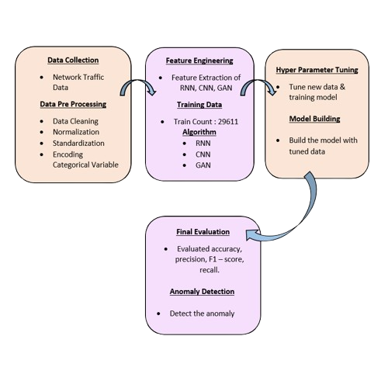
RESEARCH METHODOLOGIES
In the research methodology section, This paper addresses the problem of detecting anomalies in network traffic data using deep learning techniques. The goal is to automatically detect anomalies such as unauthorized access, cyber threats, or malicious behavior. Deep learning techniques, including CNNs, RNNs, Autoencoders, and GANs, are utilized for their ability to reduce false positive rates, improve accuracy, and detect anomalies automatically. The following subsections provide a detailed overview of each technique, their implementation, and the evaluation metrics used.
Flow Chart

Slide 12
RNN (Recurrent Neural Network):
In this paper, RNN (Recurrent Neural Network): RNNs, particularly LSTM-based autoencoders, were chosen for their ability to capture temporal dependencies in sequential data. Since network traffic data often contains time-dependent patterns, RNNs are particularly well-suited for anomaly detection in such contexts.
CNN (Convolutional Neural Network):
In this paper, CNN (Convolutional Neural Network): The CNN auto encoder model was selected for anomaly detection due to its efficiency in extracting local patterns from sequential data, such as network traffic, through convolutional layers. CNNs are especially suitable for detecting spatial relationships and patterns, making them well-suited for network traffic analysis, where localized features are critical.
GAN (Generative Adversarial Network):
In this paper, GAN (Generative Adversarial Network): GANs were chosen for their ability to generate synthetic network traffic data and differentiate between real and anomalous traffic patterns. The adversarial nature of GANs makes them powerful for anomaly detection, as the discriminator learns to distinguish between real and synthetic data, indirectly learning the characteristics of anomalies.

Slide 13
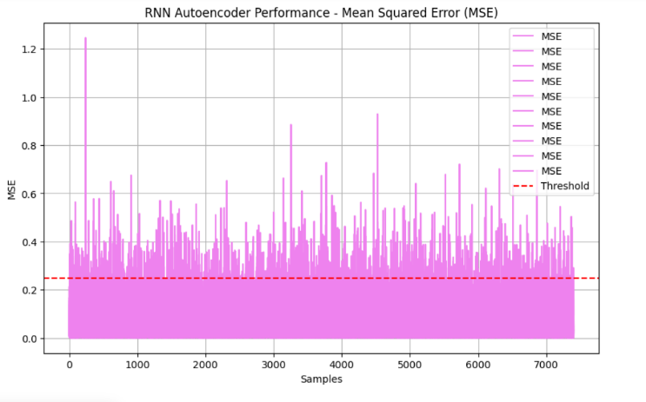
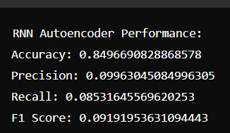
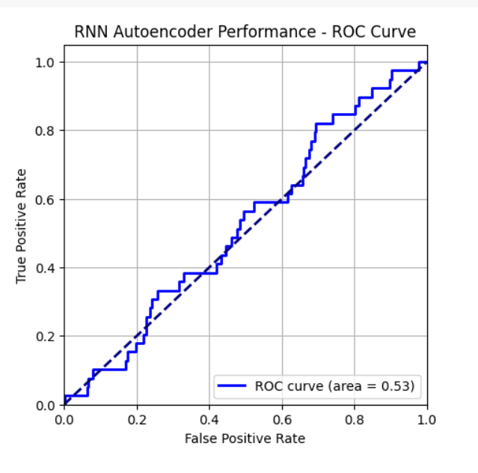
RESULT & ANALYSIS
RNN (Recurrent Neural Network):

Slide 14
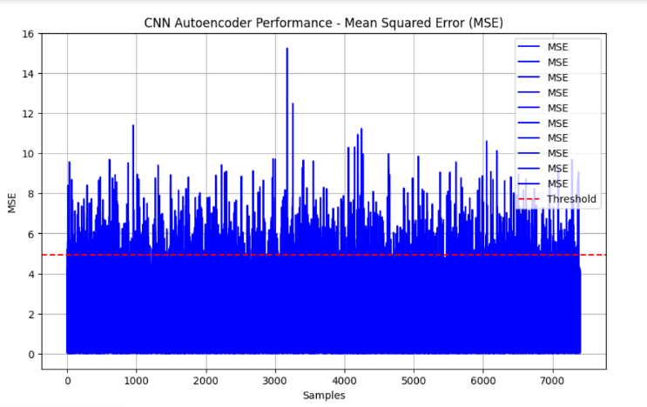
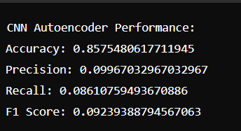
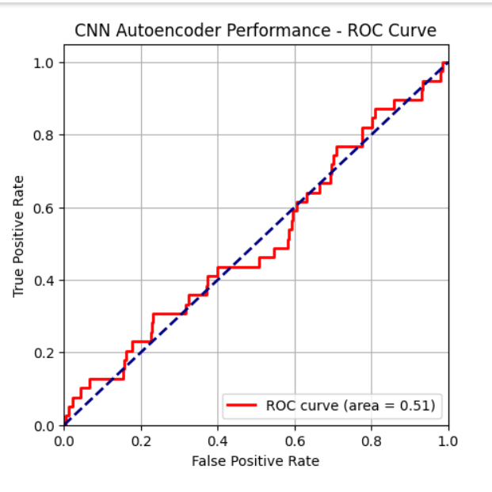
CNN(Convolutional Neural Network):

Slide 15
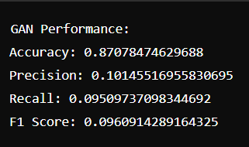
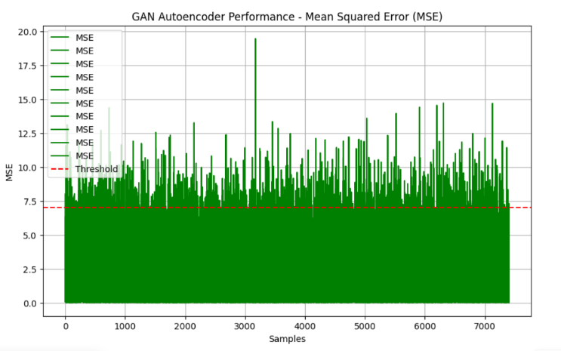
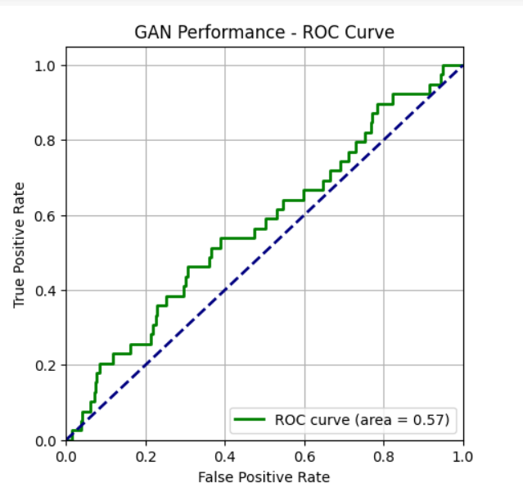
GAN(Generative Adversarial Network):

Slide 16
CONCLUSION
This research demonstrates the effectiveness of CNN, RNN, and GAN autoencoders in detecting anomalies in network traffic data. Each method leverages deep learning to address complex pattern recognition and anomaly detection challenges. The CNN model uses Conv1D and MaxPooling1D layers for feature extraction and reconstruction, while the RNN model employs LSTM layers to manage sequential data. The GAN autoencoder combines a generator and discriminator to enhance detection accuracy by distinguishing between real and synthetic data. Evaluating these models with Mean Squared Error (MSE) and performance metrics such as accuracy, precision, recall, and F1 score that provides a thorough assessment of their capabilities. These advanced techniques aim to reduce false positives and achieve high accuracy in identifying unauthorized access, cyber threats, and malicious activities, thereby enhancing overall network security. In future work, the detected anomalies identified by the deep learning models will be managed and mitigated using a virtual assistant system. This virtual assistant will be designed to respond in real-time to alerts generated by the anomaly detection models, automatically implementing corrective actions to neutralize threats. By integrating automated response mechanisms, the virtual assistant will help to quickly address and mitigate anomalies, enhancing network security and reducing the potential impact of detected threats. This approach aims to further streamline the anomaly management process and improve overall system resilience.

Slide 17
REFERENCES
[1] Gioacchini, L., et al. (2024). Generic Multi-modal Representation Learning for Network Traffic Analysis. arXiv preprint arXiv.LG.
[2] Pekar, A., & Jozsa, R. (2024). Evaluating ML-Based Anomaly Detection Across Datasets of Varied Integrity: A Case Study. arXiv preprint arXiv .LG.
[3] Maddireddy, B. R., & Maddireddy, B. R. (2024). Neural Network Architectures in Cybersecurity: Optimizing Anomaly Detection and Prevention. International Journal of Advanced Engineering Technologies and Innovations, 1(2), 238.
[4] Arjunan, T. (2024). Real-Time Detection of Network Traffic Anomalies in Big Data Environments Using Deep Learning Models. International Journal for Research in Applied Science & Engineering Technology (IJRASET), 12(3), 844.
[5] Lim, W., Yong, K. S. C., Lau, B. T., & Tan, C. C. L. (2024). Future of Generative Adversarial Networks (GAN) for Anomaly Detection in Network Security: A Review. Computers & Security, 139, 103733.

Slide 18
[6] Gunnam, S. R., Vepuri, S. K., & Nallarasan, V. (2024). Detection of Real-Time Malicious Intrusions Using GAN (Generative Adversarial Networks) in Cyber Physical System. In Proceedings of the 2024 5th International Conference for Emerging Technology (INCET) (pp. XXX-XXX). IEEE.
[7] Khalaf, L. I., Alhamadani, B., Ismael, O. A., Radhi, A. A., Ahmed, S. R., & Algburi, S. (2024). Deep Learning-Based Anomaly Detection in Network Traffic for Cyber Threat Identification. In Proceedings of the Cognitive Models and Artificial Intelligence Conference (AICCONF '24) (pp. 303-309).
[8] Improved Domain Generation Algorithm to Detect Cyber-Attack with Deep Learning Techniques. (2022).
[9] Abdelmoumin, G., Rawat, D. B., & Rahman, A. (2021). On The Performance of Machine Learning Models for Anomaly-Based Intelligent Intrusion Detection Systems for The Internet of Things. IEEE Internet of Things Journal.
[10] Kuang, C. (2021). Research on Network Traffic Anomaly Detection Method Based on Deep Learning. Journal of Physics: Conference Series, 1861(1), 012007. IOP Publishing.

Slide 19
[11] Fotiadou, K., Velivassaki, T.-H., Voulkidis, A., Skias, D., Tsekeridou, S., & Zahariadis, T. (2021). pfSense Network Traffic Anomaly Detection via Deep Learning. Information, 12(5), 215. MDPI.
[12] Lim, Willone, Kelvin Yong Sheng Chek, Lau Bee Theng, and Colin Tan Choon Lin. "Future of generative adversarial networks (GAN) for anomaly detection in network security: A review." Computers & Security (2024): 103733.
[13] Khalaf, Luay Ibrahim, Baydaa Alhamadani, Omar Ayad Ismael, Ahmed A. Radhi, Saadaldeen Rashid Ahmed, and Sameer Algburi. "Deep Learning-Based Anomaly Detection in Network Traffic for Cyber Threat Identification." In Proceedings of the Cognitive Models and Artificial Intelligence Conference, pp. 303-309. 2024.
[14] Iliyasu, Auwal Sani, and Huifang Deng. "N-GAN: a novel anomaly-based network intrusion detection with generative adversarial networks." International Journal of Information Technology 14, no. 7 (2022): 3365-3375.
[15] Gunnam, Sanjay Reddy, Sameer Kumar Vepuri, and V. Nallarasan. "Detection of Real Time Malicious Intrusions Using GAN (Generative Adversarial Networks) in Cyber Physical System." In 2024 5th International Conference for Emerging Technology (INCET), pp. 1-7. IEEE, 2024.

